Slide 1


The Right Amount of Trust
Jeff Butler
(EIEF)
Paola Giuliano
(UCLA)
Luigi Guiso
(EUI & EIEF)
Moscow April 5 2010
March 22 2009
Notes:
1

Slide 2
The rise of trust
Big and pervasive effects of trust
Strongly correlates with GDP per capita and growth (Knack and Keefer; Algan and Cahuc)
Allows firms to grow larger (Shleifer et al.) and institutions to improve their quality (Tabellini)
Raises access to financial markets, increases investment in stocks (Guiso, Sapienza and Zingales; Cole et. al.)
Affects economic and financial transactions across countries (Guiso, Sapienza and Zingales), venture capital investments (Bottazzi and Darin)
Improves managerial practices and firm organization (Bloom et al)
Notes:
Algan and Cahuc

Slide 3
Trust and economic performance
In this literature trust is always good➔ the more the better
Economic performance increases monotonically with trust
Idea (Arrow): trust is a key ingredient in virtually all transactions➔ more exchange more creation of surplus
Notes:
Algan and Cahuc

Slide 4
Questions and Doubts
Is it true that trust always generates more surplus?
Does it always pay an individual to trust?
Old and recent financial scandals may raise doubts that this is actually the case
Notes:
4

Slide 5
Our contribution
Focus on the link between individual trust and individual performance
Argue performance is hump-shaped in own trust beliefs
  Very trustworthy individuals will form too optimistic beliefs
  ➔ they trust and trade too much with the risk of being cheated (and this reduces performance)
  Un-trustworthy individuals will form too conservative beliefs
  ➔ they do not trust and trade too little, loosing profitable opportunities as a result
Notes:
5

Slide 6
Trust Beliefs: Density Functions by Country
High trust
Medium trust
Low trust
Bottom line: massive heterogeneity in beliefs within the same community
Notes:
6
A lot of heterogeneity across countries in mean or median trust=> country fixed effects
A lot of heterogeneity within country across individuals=> exploit the latter

Slide 7
Where is persistent heterogeneity coming from?
Two explanations:
Parents endow children with priors about others and cultural priors are hard to change – e.g. because of confirmation bias (GSZ, 2008; Dohmen et. al. 2007)
Parents endow children with values (Bisin and Verdier, 2000, 2001; Tabellini,2009) and people extrapolate beliefs from their own trustworthiness
Both values and false consensus are persistent
  Back with evidence on this later
Notes:
7
confirmation bias - a tendency to seek and find confirmatory evidence in support of already existing beliefs and ignore or reinterpret disconfirmatory evidence.

Slide 8
Outline
A simple model tying false consensus and the hump shaped relationship between trust and performance
Field data evidence
  Relationship between trust and performance
  The relationship between trust and being cheated
Experimental evidence
  Show evidence of culturally driven trust beliefs coupled with the tendency of individuals to extrapolate from their own type
  Hump shaped performance-trust relation
Notes:
8

Slide 9
A simple model
Investor has capital but no ideas
Partner (e.g. an Entrepreneur) has ideas but not capital and he/she can cheat (Dixit, 2003)
E= investor endowment
S= amount the investor lends
f(S) output produced if invest S
π fraction of cheaters in the population
p subjective probability of being cheated
Investor’s problem:

Slide 10
Solution
The solution with correct beliefs is a level of income:
Let’s p the subjective trust belief:
An investor’s average income is a concave function of the investor’s trust beliefs, which attains it maximum when the investor’s belief about the share of trustworthy partners, 1-p, equals the true share of trustworthy entrepreneurs, 1-π

Slide 11
Solution: graphics
Y
Correct belief
Too little
trust
Too much trust
1-π
1
1-p
Notes:
11

Slide 12
Predictions
  Individual performance should peak at intermediate trust and be lower for very low and very high trust
  Peak more to the right in high-trust countries
  More trusting people more likely to be cheated
  Less trusting people more likely to miss profitable opportunities

Slide 13
Trust, performance and cheating: empirical evidence
Dataset description
Trust and performance
Trust and cheating

Slide 14
Data
European Social Survey (wave 2)
  Covers 26 European countries
  About 2000 randomly sampled individuals for each country
  Standard information on household demographics
Trust “generally speaking, would you say that most people can be trusted, or that you can’t be too careful in dealing with people?”
  Score of 0 to 10
  Performance is measured with household total disposable income (only measure available)
  12 categories are available ranging from less than 1800 euros per year to more than 120,000 euros per year
  Assign midpoint of range and take logs

Slide 15
Trust and performance: evidence
Regress log income (Y) on 10 trust-level dummies: excluded group lowest trust level
Controls (X): age, education, gender, marital status, parents education, immigrant, employment status
Control for risk tolerance and altruism
Full set of country effects➔
  absorb systematic differences in average actual trustworthiness and any other relevant country-level effect
Full set of regional effects➔
  absorb systematic within country differences in trustworthiness

Slide 16
The trust-performance relation
 | Demographics | + risk tolerance | + altruism | Quadratic
Trust 1 | 0.003 | 0.004 | 0.006
Trust 2 | 0.031 | 0.039 | 0.035
Trust 3 | 0.071*** | 0.081*** | 0.086***
Trust 4 | 0.082*** | 0.083*** | 0.081***
Trust 5 | 0.081*** | 0.083*** | 0.085***
Trust 6 | 0.119*** | 0.126*** | 0.124***
Trust 7 | 0.134*** | 0.142*** | 0.142***
Trust 8 | 0.138*** | 0.145*** | 0.145***
Trust 9 | 0.133*** | 0.138*** | 0.141***
Trust 10 | 0.071* | 0.079* | 0.091**
Risk tolerance |  | 0.015*** | 0.014** | 0.015***
Trust |  |  |  | 0.030***
Trust squared |  |  |  | -0.002**
Altruism |  |  | -0.019**
Notes:
16

Slide 17
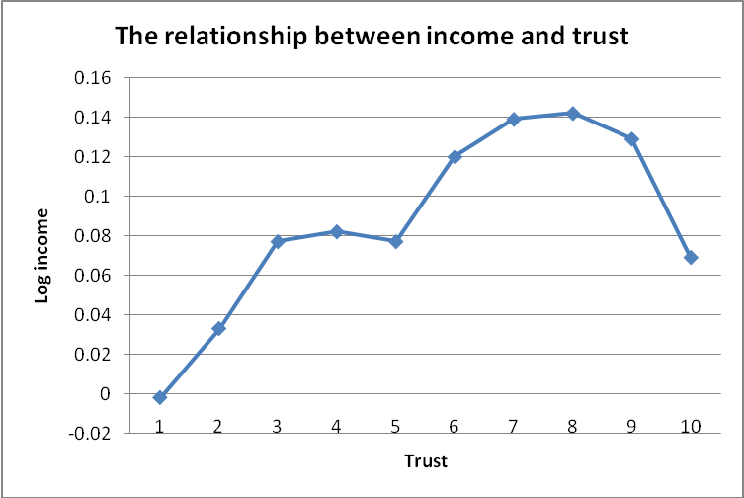
The Trust-Income relation
Notes:
17

Slide 18
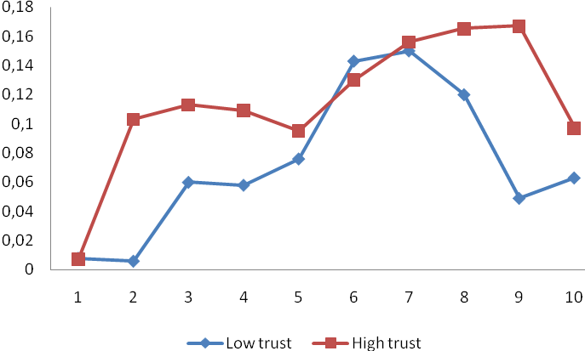
It peaks earlier in low trust countries

Slide 19
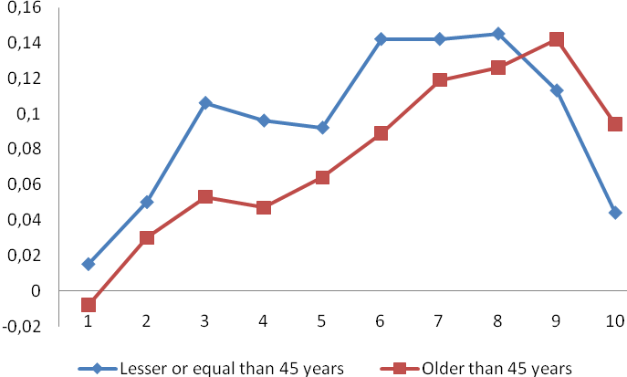
Does not vanish with experience
Trust and income by age
Notes:
19

Slide 20
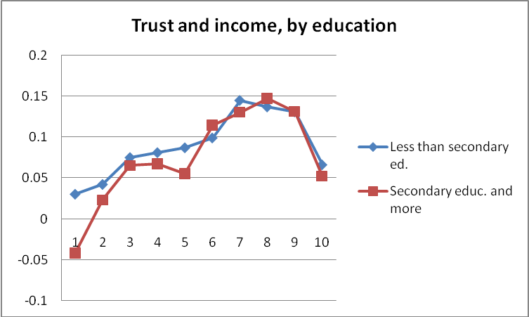
…nor with education
Notes:
20

Slide 21
Trust and performance: comments
Unlikely to be driven by reverse causality
  If more income generates more trust, can explain rising portion but not falling one
  If it implies less trust, can explain falling portion not rising one
Effects economically important: Compared to the pick
  A trust of 2 => an income 11 percentage points lower than peak income
  A trust of 10=> an income 7 percentage points lower than peak income
  Effects of same order of magnitude as returns to high education

Slide 22
Objection 1: In medio stat virtus
trust may be picking up unobserved heterogeneity => economic success determined by “moderate attitudes” which happen to be correlated with moderate trust
Allow for non-monotonic effects of:
  Risk tolerance (5 categories)
  Generosity and loyalty (11 categories)
  Political preferences (left- right, 11 categories)
  Religious beliefs (0 to 10)
Hump-shaped effect of trust unchanged
Only trust and political preferences have a hump shaped relation, but trust robust to political preferences=> does not reflect moderation
Notes:
22

Slide 23
Objection 2: Wealthier people more precise info about others’ trustworthiness
This implies beliefs are more spread out at low income and less at high income levels generating a hump even when no systematic relation. If so standard deviation of trust negatively correlated with income.
But this is not in the data
Notes:
23

Slide 24
Digging deeper into mechanism
Too much trust hampers performance because exposes one to:
  Larger losses if cheated
  Higher chances of being cheated (GSZ)
Too much mistrust hampers performance because causes individuals to miss profit opportunities
We have info on whether and how often individual is cheated, not on missed opportunities
Test whether chances of being cheated increase with trust

Slide 25
Data on cheating experience
“How often, if ever, have each of these things happened to you in the last five years?”
  “A bank or insurance company failed to offer you the best deal you were entitled to”
  “A plumber, builder, car mechanic or other repair person overcharged you or did unnecessary work”
  “You were sold food that was packed to conceal the worse bits ”
  “You were sold something second-hand that quickly proved to be faulty”
    1 Never; 2 Once; 3 Twice; 4 3 or 4 times; 5 5 times or more

Slide 26
Cheating distributions
Bank/insurance
Second hand
Plumber, mechanic
Food
Notes:
26

Slide 27
Trust and cheating: problem
Problem when testing effect of trust on chances of being cheated: people learn and if cheated revise prior downwards
  Learning biases towards finding a negative relation
Account for this with IV. Rely on false consensus and obtain proxies for own trustworthiness:
  Amount of delegation that is granted by his\her boss at work
    a) freedom to organize daily work; b) power to influence decisions about activities of the organization; c) freedom to choose pace of their work
  Construct a single index of trustworthiness taking the mean of the delegation on the there domains
Under FC: higher trustworthiness => higher trust
Being cheated is private information and thus unobserved by one’s boss => delegation orthogonal to error

Slide 28
Cheating: model
Measurement issues:
  Those mistrusting more likely to report because more alerted and more likely to detect cheating => bias towards finding a negative correlation: IV also accounts for this unobserved heterogeneity
  What is cheating may vary across subjects/cultures=> country and regions FE can take care of this

Slide 29
Trust and cheating: first stage
 | Bank Insurance | Second hand things | Food | Plumber, builder, mechanic, repairer | Times being cheated (sum)
Trustworthiness (Delegation index ) | .0084*** | .0078*** | .0082*** | .0087*** | .0089***
 | (.0020) | (.0019) | (.0019) | (.0019) | (.0021)
Observations | 21163 | 22663 | 23062 | 22463 | 19774
R-squared | 0.23 | 0.23 | 0.23 | 0.23 | 0.24
Notes:
29

Slide 30
Trust and cheating: IV estimates
 | Bank insurance | Second hand things | Food | Plumber, builder, mechanic, repairer | Times being cheated (sum)
Trust | 0.817*** | 0.234** | 0.599*** | 0.534*** | 2.271***
Age | 0.010* | -0.008*** | 0.013*** | 0.008* | 0.016
Age squared | -0.000*** | -0.000 | -0.000*** | -0.000*** | -0.001***
Male | 0.099*** | 0.088*** | -0.173*** | 0.112*** | 0.128
Immigrant | 0.009 | 0.043* | -0.004 | 0.033 | 0.046
Married | -0.160*** | -0.059** | -0.108** | -0.174*** | -0.538***
Single | -0.279*** | -0.047 | -0.235*** | -0.254*** | -0.795***
Primary | 0.214** | 0.103** | 0.114 | 0.117 | 0.662**
Secondary | 0.202** | 0.099*** | 0.090 | 0.090 | 0.573**
Risk tolerance | -0.009 | 0.006 | -0.031** | -0.001 | -0.043
Log income | -0.049 | -0.036** | -0.030 | -0.017 | -0.133
Big city | 0.095** | 0.024 | 0.195*** | 0.113*** | 0.481***
Small city | 0.123*** | 0.058*** | 0.166*** | 0.114*** | 0.489***
Observations | 21163 | 22633 | 23062 | 22463 | 19774
Notes:
30

Slide 31
Trust & cheating: effects
A one SD increase in trust:
Raises the N. of times one is cheated by a plumber by 1.7 times the sample mean and that when buying second hand by 65%
Increases N. of times one is cheated when buying food by as much as the sample mean
Triples N. of times one is cheated by a bank

Slide 32
Immigrants, persistence and learning
Exploit information on country of origin of immigrants and variation in trust across countries of origin
Immigrants from high trust countries more likely to be cheated than immigrants from low trust countries
Exclude reverse causality due to beliefs revision
Effect should be stronger for the first generation and for recent immigrants compared to immigrants who arrived further in the past

Slide 33
Persistence: the evidence
 | (1) | (2) | (3) | (4) | (5)
 | Bank Insurance | Second hand Things | Food | Plumber, builder, mechanic, Repairer | Times being cheated (sum)
Trust c.o -first gen. | 0.271** | 0.080 | 0.666*** | 0.348* | 1.491***
 | (0.103) | (0.154) | (0.220) | (0.195) | (0.489)
Trust c.o -second gen. | -0.031 | 0.127 | -0.224 | -0.066 | -0.493
 | (0.194) | (0.211) | (0.171) | (0.265) | (0.614)
Freeing oneself from FCE can take as long as one generation
Notes:
33

Slide 34
Persistence: the evidence
 | Bank Insurance | Second hand Things | Food | Plumber, builder, Mechanic, repairer | Times being cheated (sum)
Trust c.o. : new arrivals | 0.663* | 0.292 | 0.473 | 0.770** | 2.022*
 | (0.381) | (0.279) | (0.444) | (0.332) | (1.056)
Trust c.o.: old arrivals | 0.206 | 0.114 | 0.425 | 0.123 | 1.190
 | (0.189) | (0.196) | (0.294) | (0.312) | (0.810)
Effect stronger among new arrivals (less than 20 years)

Slide 35
Evidence from a trust game
  Perform a trust game experiment on a sample of 124 college students
  Subjects play repeatedly
  At each round they are randomly assigned either the role of sender or that of receiver => we can measure
    Their behavioral trust (when they plays as senders)
    Their trustworthiness (when they play as receivers)
    Their trust beliefs (expectations about average amounts returned) at each round
  Independent information, prior to the experiment, on the effort parents put in teaching trustworthiness as a value to their kids
Notes:
35

Slide 36
Own and expected trustworthiness
Distribution of trust beliefs
Distribution of initial trustworthiness
Massive heterogeneity in pure beliefs
Massive heterogeneity in trustworthiness
Are the two correlated? => False consensus
Notes:
36

Slide 37
Trust beliefs and initial own trustworthiness
 | Rounds 1-3 | Rounds 4-6 | Rounds 7-9 | Rounds 10-12
 | Trust beliefs | Trust beliefs | Trust beliefs | Trust beliefs
Initial own trustworthiness | 0.744*** | 0.542*** | 0.475*** | 0.452***
 | (0.0419) | (0.0652) | (0.0748) | (0.0766)
Constant | 0.0848*** | 0.106*** | 0.0763*** | 0.0653**
 | (0.0161) | (0.0232) | (0.0264) | (0.0246)
Observations | 276 | 208 | 171 | 171
R-squared | 0.586 | 0.312 | 0.261 | 0.249

Slide 38
Where is initial trustworthiness coming from?
Initial trustworthiness on “good values”
 | Initial trustworthiness
Parent’s transmitted values | 0.169*
 | (0.0928)
Constant | 0.211***
 | (0.0597)
Observations | 83
R-squared | 0.039

Slide 39
IV estimates: trust beliefs on initial trustworthiness
 | Rounds 1-3 | Rounds 4-6 | Rounds 7-9 | Rounds 10-12
 | Trust beliefs | Trust beliefs | Trust beliefs | Trust beliefs
Initial own trustworthiness | 0.992** | 0.951*** | 0.751** | 0.286
Constant | 0.0111 | -0.0130 | -0.0105 | 0.113
Observations | 249 | 188 | 153 | 153

Slide 40
Cultural values and trust beliefs: reduced forms
 | Rounds 1-3 | Rounds 4-6 | Rounds 7-9 | Rounds 10-12
 | Trust beliefs | Trust beliefs | Trust beliefs | Trust beliefs
Parents transmitted values | 0.122** | 0.125* | 0.122* | 0.0515
Constant | 0.246*** | 0.197*** | 0.143*** | 0.171***
Observations | 339 | 262 | 216 | 216

Slide 41
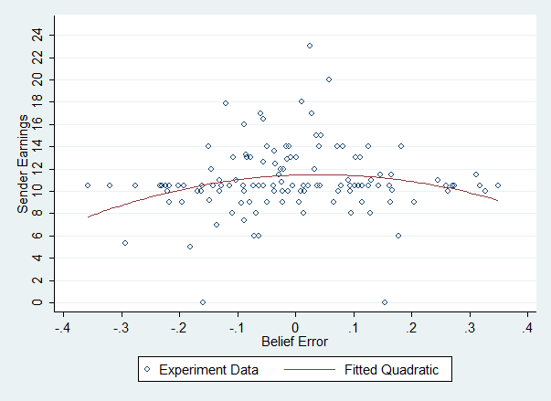
Trust beliefs and performance in the experiment
Hump shape confirmed in on line experiment => rule out reverse causality and heterogeneity in trustworthiness of pool one interacts with
Senders with correct beliefs make 20% more income than those with either too low or too high trust
Notes:
41

Slide 42
Conclusion
Miscalibrated trust beliefs can be individually costly
Costs can be substantial:
  Our estimates: losses entailed by poorly calibrated beliefs are as important as returns to education
Is it better to exceed in trust or to mistrust?
Both excesses are individually costly, but exceeding in mistrust is individually more costly than exceeding in trust
Mistrust also socially costly as it reduces the creation of surplus
Exceeding in trust, while costly to the individual, may be beneficial to society as it promotes surplus creation.
Reconciles hump-shaped relation in individual data and monotonically increasing relation in aggregate data
Notes:
42
Krugman: whole financial industry is a huge Madoff game

